Slide 1

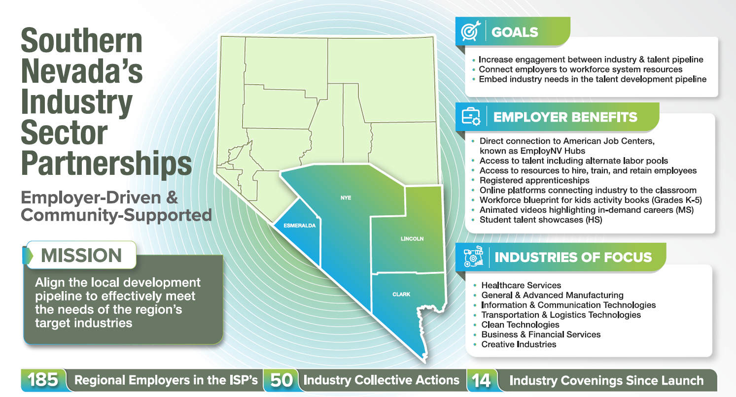
Southern Nevada’s Industry Sector Partnerships (ISPs) update.
Enrollments and employment metrics for 1Q PY23.

